Slide 1
Determinants

Slide 2
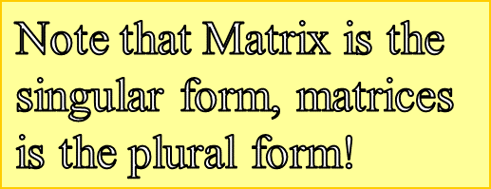
Matrices
A matrix is an array of numbers that are arranged in rows and columns.
A matrix is “square” if it has the same number of rows as columns.
We will consider only 2x2 and 3x3 square matrices
1
3
-½
0
-3
8
¼
2
0
-¾
4
180
11

Slide 3
Determinants
Note the difference in the matrix and the determinant of the matrix!
1 | 3
-½ | 0
Every square matrix has a determinant.
The determinant of a matrix is a number.
We will consider the determinants only of 2x2 and 3x3 matrices.
-3 | 8 | ¼
2 | 0 | -¾
4 | 180 | 11

Slide 4
Why do we need the determinant
It is used to help us calculate the inverse of a matrix and it is used when finding the area of a triangle

Slide 5
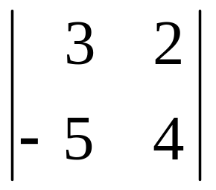
Finding Determinants of Matrices
Notice the different symbol:
the straight lines tell you to
find the determinant!!
=
-
(-5 * 2)
(3 * 4)
=
12 - (-10)
=
22

Slide 6
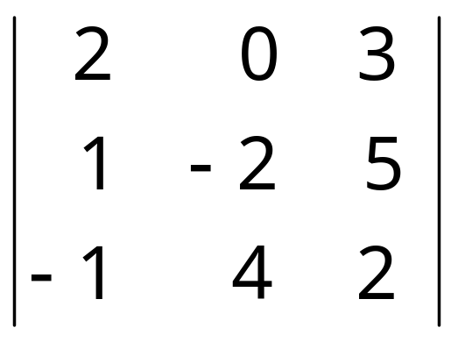
Finding Determinants of Matrices
2
0
1
-2
-1
4
= [(2)(-2)(2) + (0)(5)(-1) + (3)(1)(4)]
[(3)(-2)(-1) + (2)(5)(4) + (0)(1)(2)]
-
=
[-8 + 0 +12]
-
[6 + 40 + 0]
=
4 – 6 - 40
= -42

Slide 7
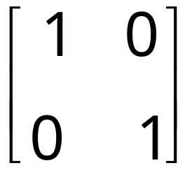
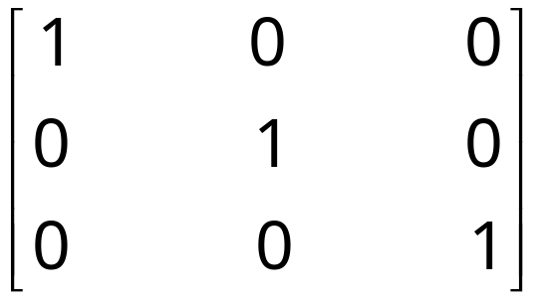
Using matrix equations
Identity matrix:
Square matrix with 1’s on the diagonal and zeros everywhere else
2 x 2 identity matrix
3 x 3 identity matrix
The identity matrix is to matrix multiplication as ___ is to regular multiplication!!!!
1

Slide 8
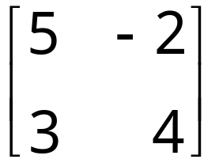
Multiply:
=
=
So, the identity matrix multiplied by any matrix
lets the “any” matrix keep its identity!
Mathematically, IA = A and AI = A !!

Slide 9
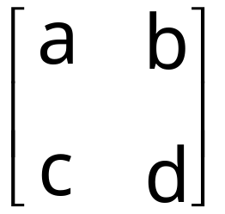
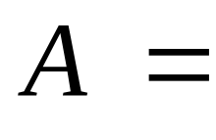
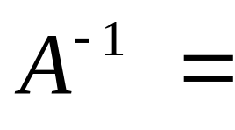
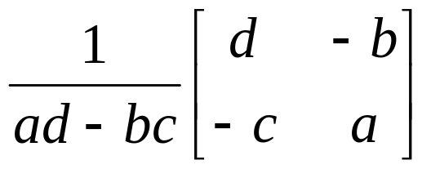
Using matrix equations
Inverse Matrix:
2 x 2
In words:
Take the original matrix.
Switch a and d.
Change the signs of b and c.
Multiply the new matrix by 1 over the determinant of the original matrix.

Slide 10
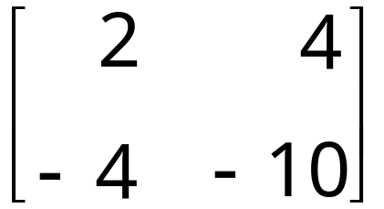
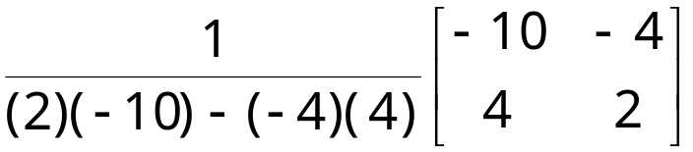
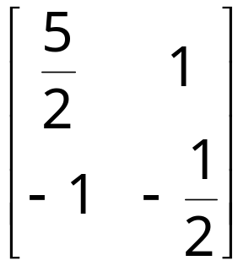
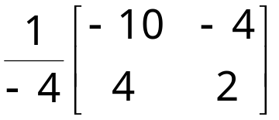
Using matrix equations
Example: Find the inverse of A.
=

Slide 11
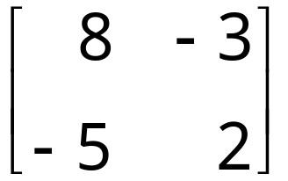
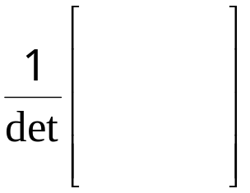
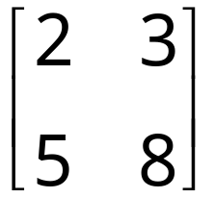

Find the inverse matrix.
Inverse =
Matrix
Reloaded
Matrix A
Det A = 8(2) – (-5)(-3) = 16 – 15 = 1
=
=

Slide 12
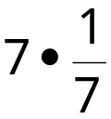
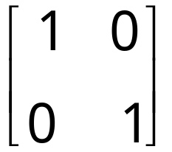
What happens when you multiply a matrix by its inverse?
1st: What happens when you multiply a number by its inverse?
A & B are inverses. Multiply them.
=
So, AA⁻¹ = I

Slide 13
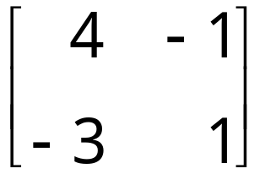
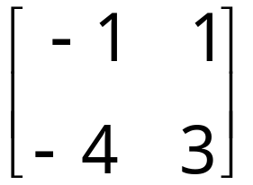
Why do we need to know all this?
To Solve Problems!
Solve for Matrix X.
X
=
We need to “undo” the coefficient matrix.
Multiply it by its INVERSE!
X
=
X
=
X
=

Slide 14
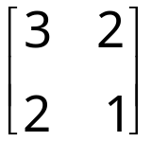

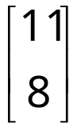
Using matrix equations
You can take a system of equations and write it with
matrices!!!
3x + 2y = 11
2x + y = 8
becomes
=
Answer matrix
Coefficient
matrix
Variable
matrix

Slide 15
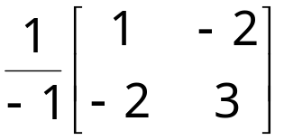
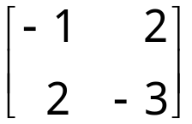
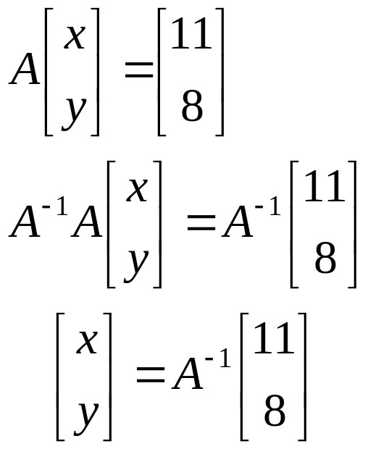
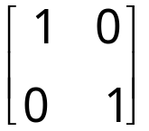
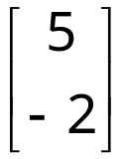
Using matrix equations
=
Example: Solve for x and y .
Let A be the coefficient matrix.
Multiply both sides of the equation by the inverse of A.
-1
=
=
=
=
=

Slide 16
Using matrix equations
Wow!!!!
It works!!!!
x = 5; y = -2
Check:
3x + 2y = 11
2x + y = 8
3(5) + 2(-2) = 11
2(5) + (-2) = 8

Slide 17
You Try…
Solve:
4x + 6y = 14
2x – 5y = -9
(1/2, 2)

Slide 18
You Try…
Solve:
2x + 3y + z = -1
3x + 3y + z = 1
2x + 4y + z = -2
(2, -1, -2)

Slide 19
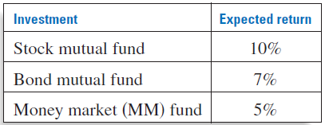
Real Life Example:
You have $10,000 to invest. You want to invest the money in a stock mutual fund, a bond mutual fund, and a money market fund. The expected annual returns for these funds are given in the table.
You want your investment to obtain an overall annual return of 8%. A financial planner recommends that you invest the same amount in stocks as in bonds and the money market combined. How much should you invest in each fund?

Slide 20
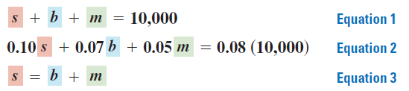

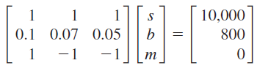

Slide 21



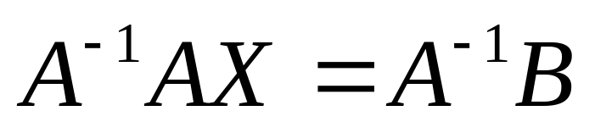
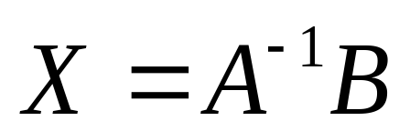
To isolate the variable matrix, RIGHT multiply by the inverse of A
Solution: ( 5000, 2500, 2500)

